Slide 1
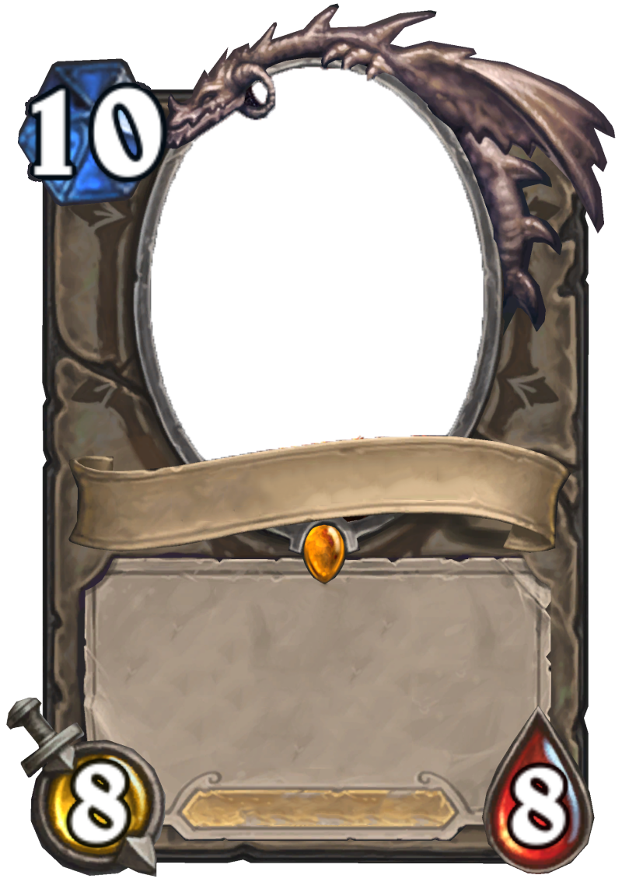

Continuously Practicing Java
Kimminich
Björn
with the
«Trading Card Game»
Kata
Battlecry: Draw a slide.
Deathrattle: Transform
audience into 1/1 sheep.
Lecturer
V1.0 (02.12.2014)

Slide 2
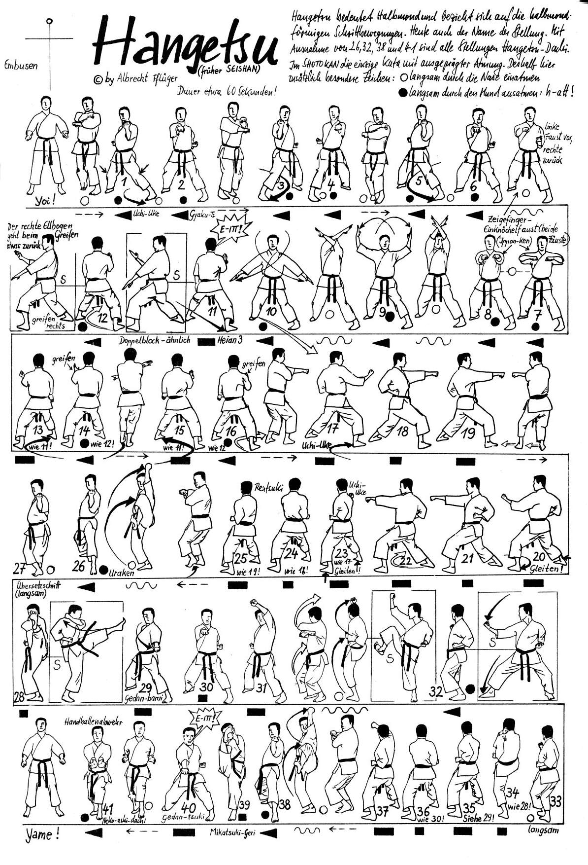
Kata
Kata (型 or 形 literally: "form”) is a Japanese word describing detailed choreographed patterns of movements practiced either solo or in pairs.

Slide 3
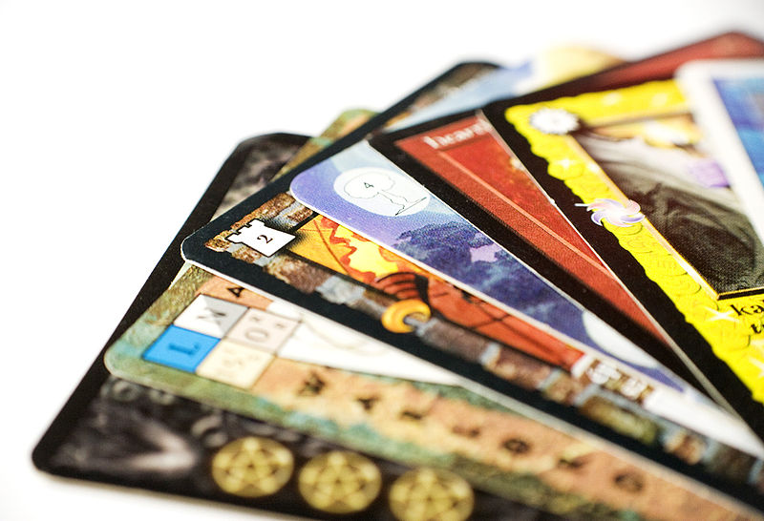
Trading Card Game (TCG)
A […] trading card game (TCG) […] is a card game that uses specially designed sets of playing cards […] mass-produced for trading or collectibility, and it must have rules for strategic game play. Acquiring these cards may be done by trading with other players or buying card packs.

Slide 4
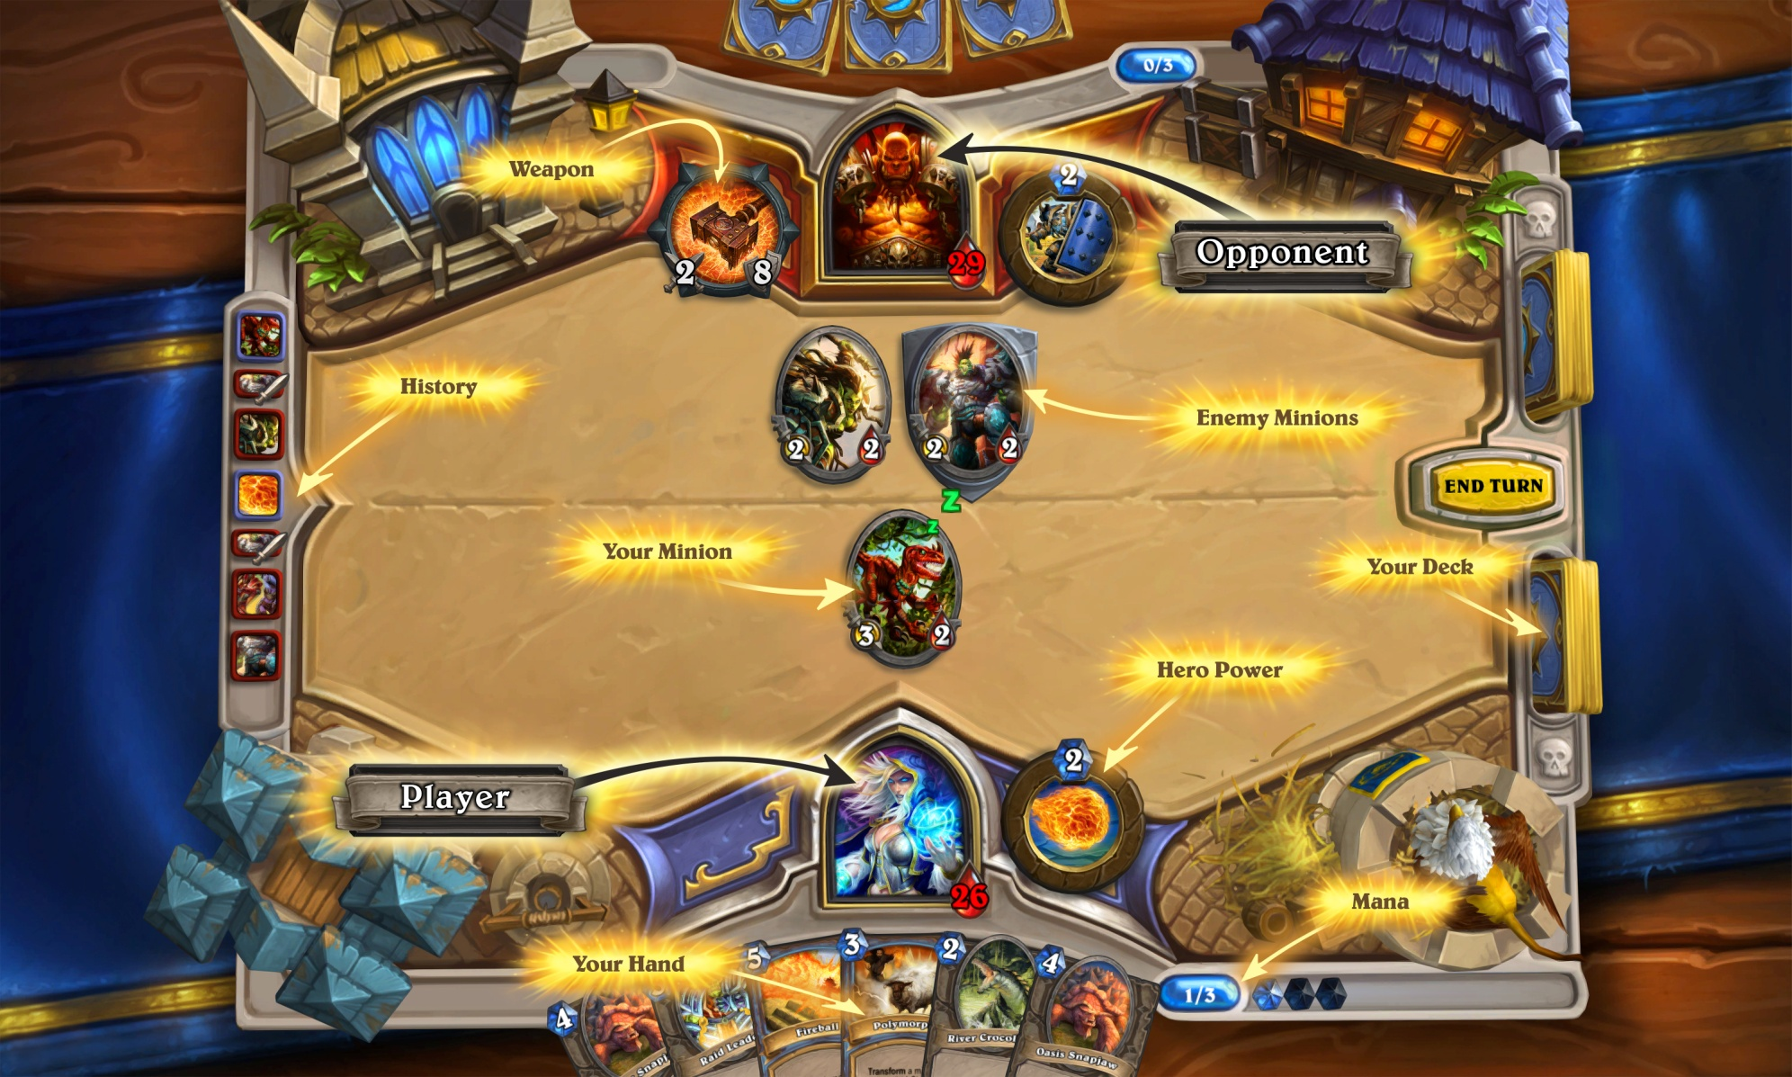
Hearthstone: Heroes of Warcraft®

Slide 5
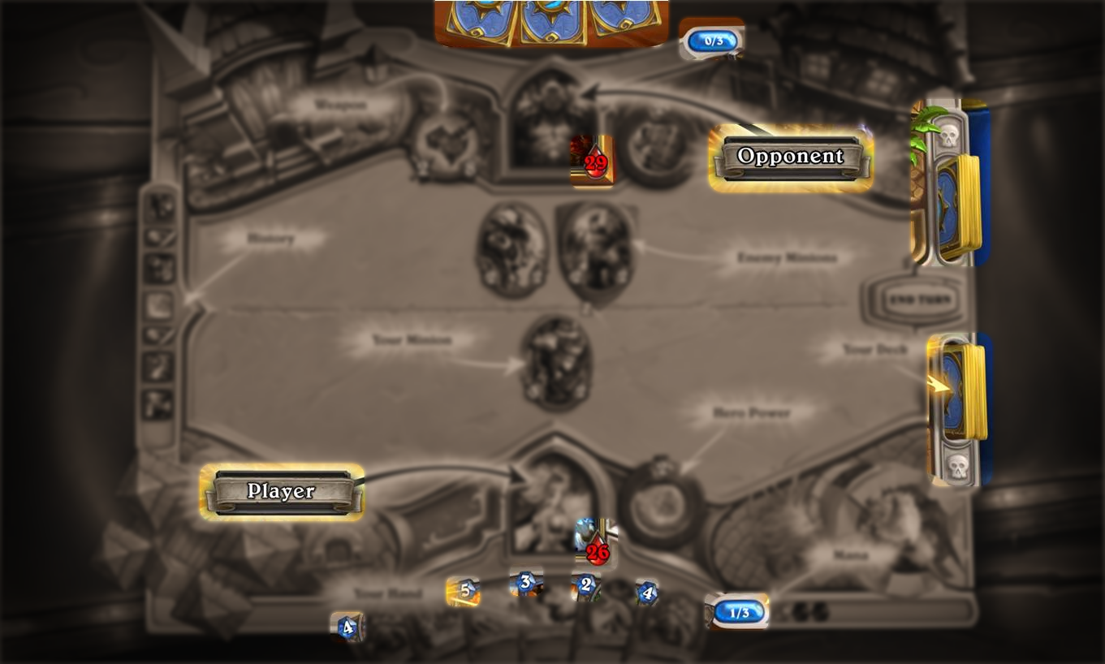
Kata Trading Card Game

Slide 6

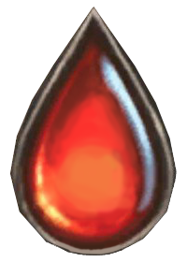

Player Setup
Health
Mana
Hand
30
0/0
0
0
1
1
2
2
2
3
3
3
Deck
3
4
4
4
5
5
6
6
7
8

Slide 7

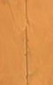
Gameplay
Receive +1
Mana Slot
Active Player
Cause
1 Damage
Replenish
Mana
Game Table
Pay 1
Mana
-1
0/0
0/1
30
1/1
0/0
30
29
1
3
5
3
2
2
Play Card 1
Draw Card
Draw extra Card
8
7

Slide 8
Forced Turn Skip
0/1
30
2/2
1/1
29
3
5
8
3
2
2
7
2
No affordable Cards
4

Slide 9
Ongoing Gameplay
-2
0/2
30
2/2
1/1
29
27
3
5
8
2
4
3
2
2
7
2
4

Slide 10
Overload Rule
18
8/8
7/7
12
Discard Card when Hand already holds 5 Cards
5
8
6
1
7
0
8
7
2
4

Slide 11
Mana Cap
8
10/10
10/10
4
5
6
Mana is capped at 10 Slots
6
1

Slide 12
Bleedout Rule
Cause
1 Damage
-1
8
10/10
7
10/10
4
Drawing from empty Deck
5
6
6
1

Slide 13
Game End
-6
10/10
7
4/10
10/10
4
-2
5
6
Loser!
6
1
Winner!

Slide 14


Kata TCG Rules & Variations
https://github.com/bkimminich/kata-tcg
Detailed rules description
Advanced Variations
Healing cards
Use cards as Minions
Different cost & damage
Card drawer cards
Deck customization

Slide 15

Thank you for your attention! Recording of the original „Practicing Advanced Unit Testing with the Trading Card Game Kata“ talk from „Agile Saturday X“ in Tallinn, Estonia https://vimeo.com/92886146
https://twitter.com/bkimminich
https://linkedin.com/in/bkimminich
https://google.com/+BjörnKimminich
http://slideshare.net/BjrnKimminich/

Slide 16
Credits
Background Image: Demonplay (Permission of use granted)
Other Images:
Blizzard Entertainment (Permission of use requested)
Wikipedia, Github
Allmystery.de, Gueball.de, Natekohl.net, Scenicreflections.com
Hearthstone: Heroes of Warcraft® is a trademark or registered trademark of Blizzard Entertainment, Inc., in the U.S. and/or other countries.

